Slide 1

Ensemble Methods (Bagging and boosting): Code along with Python

Slide 2
In this session, you will learn about:
Introduction to Ensemble Learning
Introduction to common ensemble Techniques
Bagging
Boosting
Problem Statement and initial code
Application of Algorithms based on Bagging and Boosting
Random Forest – Working, Code and Parameters
Bagging meta-estimator – Working, Code and Parameters
AdaBoost – Working, Code and Parameters
GBM – Working, Code and Parameters
Xgboost – Working, Code and Parameters

Slide 3
Why Ensemble Methods
Ensemble methods are meta-algorithms that combine several machine learning techniques into one predictive model in order to decrease variance (bagging) or bias (boosting)
Ensemble methods can be divided into two groups:
sequential ensemble methods where the base learners are generated sequentially (e.g. AdaBoost). The basic motivation of sequential methods is to exploit the dependence between the base learners. The overall performance can be boosted by weighing previously mislabeled examples with higher weight.
parallel ensemble methods where the base learners are generated in parallel (e.g. Random Forest). The basic motivation of parallel methods is to exploit independence between the base learners since the error can be reduced dramatically by averaging.

Slide 4
Max Voting
The max voting method is generally used for classification problems. In this technique, multiple models are used to make predictions for each data point. The predictions by each model are considered as a ‘vote’. The predictions which we get from the majority of the models are used as the final prediction.

Slide 5
Averaging
Similar to the max voting technique, multiple predictions are made for each data point in averaging. In this method, we take an average of predictions from all the models and use it to make the final prediction. Averaging can be used for making predictions in regression problems or while calculating probabilities for classification problems.

Slide 6
Weighted Average
This is an extension of the averaging method. All models are assigned different weights defining the importance of each model for prediction. For instance, if two of your colleagues are critics, while others have no prior experience in this field, then the answers by these two friends are given more importance as compared to the other people.

Slide 7
Bagging
Bagging is short for “Bootstrap aggregation”
Bootstrapping is a sampling technique in which we create subsets of observations from the original dataset, with replacement. The size of the subsets is the same as the size of the original set.
Multiple subsets are created from the original dataset, selecting observations with replacement.
A base model (weak model) is created on each of these subsets.
The models run in parallel and are independent of each other.
The final predictions are determined by combining the predictions(max voting) from all the models.

Slide 8
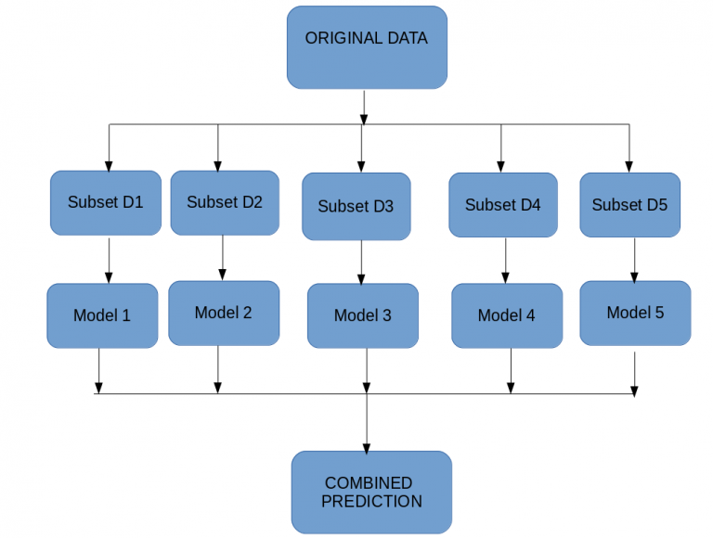
Bagging - continued

Slide 9
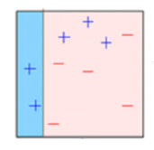
Boosting
Boosting is a sequential process, where each subsequent model attempts to correct the errors of the previous model. The succeeding models are dependent on the previous model. Let’s understand the way boosting works in the below steps
A subset is created from the original dataset.
Initially, all data points are given equal weights.
A base model is created on this subset.
This model is used to make predictions on the whole dataset.
Errors are calculated using the actual values and predicted values.
The observations which are incorrectly predicted, are given higher weights(Blue points.

Slide 10
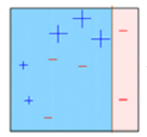
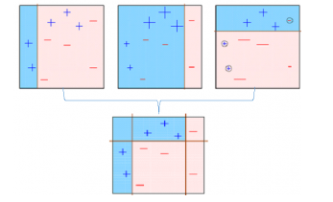
Boosting continued
Another model is created and predictions are made on the dataset. (This model tries to correct the errors from the previous model)
8. Similarly, multiple models are created, each correcting the errors of the previous model.
9. The final model (strong learner) is the weighted mean of all the models (weak learners).
Thus, the boosting algorithm combines a number of weak learners to form a strong learner.

Slide 11
Bagging Meta Estimator
Bagging meta-estimator is an ensembling algorithm that can be used for both classification (BaggingClassifier) and regression (BaggingRegressor) problems.
Random subsets are created from the original dataset (Bootstrapping).
The subset of the dataset includes all features.
A user-specified base estimator is fitted on each of these smaller sets.
Predictions from each model are combined to get the final result.
As an example, the snippet below illustrates how to instantiate a bagging ensemble of KNeighborsClassifier base estimators, each built on random subsets of 50% of the samples and 50% of the features
>>> from sklearn.ensemble import BaggingClassifier
>>> from sklearn.neighbors import KNeighborsClassifier
>>> bagging = BaggingClassifier(KNeighborsClassifier(),
... max_samples=0.5, max_features=0.5)

Slide 12
Bagging Meta Estimator - Parameters
base_estimator: It defines the base estimator to fit on random subsets of the dataset.
When nothing is specified, the base estimator is a decision tree.
n_estimators:
It is the number of base estimators to be created.
The number of estimators should be carefully tuned as a large number would take a very long time to run, while a very small number might not provide the best results.
max_samples:
This parameter controls the size of the subsets.
It is the maximum number of samples to train each base estimator.
max_features:
Controls the number of features to draw from the whole dataset.
It defines the maximum number of features required to train each base estimator.

Slide 13
Random Forests
Random Forest is another ensemble machine learning algorithm that follows the bagging technique. It is an extension of the bagging estimator algorithm. The base estimators in random forest are decision trees. Unlike bagging meta estimator, random forest randomly selects a set of features which are used to decide the best split at each node of the decision tree.
Random subsets are created from the original dataset (bootstrapping).
At each node in the decision tree, only a random set of features are considered to decide the best split.
A decision tree model is fitted on each of the subsets.
The final prediction is calculated by averaging the predictions from all decision trees.

Slide 14
Random Forests- Parameters
n_estimators:
It defines the number of decision trees to be created in a random forest.
Generally, a higher number makes the predictions stronger and more stable, but a very large number can result in higher training time.
max_features :
size of the random subsets of features
max_depth:
Random forest has multiple decision trees. This parameter defines the maximum depth of the trees.

Slide 15
Adaboost
Adaptive boosting or AdaBoost is one of the simplest boosting algorithms. Usually, decision trees are used for modelling. Multiple sequential models are created, each correcting the errors from the last model. AdaBoost assigns weights to the observations which are incorrectly predicted and the subsequent model works to predict these values correctly.
Initially, all observations in the dataset are given equal weights.
A model is built on a subset of data.
Using this model, predictions are made on the whole dataset.
Errors are calculated by comparing the predictions and actual values.
While creating the next model, higher weights are given to the data points which were predicted incorrectly.
Weights can be determined using the error value. For instance, higher the error more is the weight assigned to the observation.
This process is repeated until the error function does not change, or the maximum limit of the number of estimators is reached.

Slide 16
Adaboost - Parameters
base_estimators:
It helps to specify the type of base estimator, that is, the machine learning algorithm to be used as base learner.
n_estimators:
It defines the number of base estimators.
The default value is 10, but you should keep a higher value to get better performance.
learning_rate:
This parameter controls the contribution of the estimators in the final combination.
There is a trade-off between learning_rate and n_estimators.
max_depth:
Defines the maximum depth of the individual estimator.
Tune this parameter for best performance.

Slide 17
XGBoost
. XGBoost has proved to be a highly effective ML algorithm, extensively used in machine learning competitions and hackathons. XGBoost has high predictive power and is almost 10 times faster than the other gradient boosting techniques. It also includes a variety of regularization which reduces overfitting and improves overall performance. Hence it is also known as ‘regularized boosting‘ technique.
Advantages
Regularization:
Standard GBM implementation has no regularisation like XGBoost.
Thus XGBoost also helps to reduce overfitting.
Parallel Processing:
XGBoost implements parallel processing and is faster than GBM .
XGBoost also supports implementation on Hadoop.
Handling Missing Values:
XGBoost has an in-built routine to handle missing values.
Built-in Cross-Validation:
XGBoost allows a user to run a cross-validation at each iteration of the boosting process and thus it is easy to get the exact optimum number of boosting iterations in a single run.

Slide 18
XGBoost - Parameters
nthread
This is used for parallel processing and the number of cores in the system should be entered..
If you wish to run on all cores, do not input this value. The algorithm will detect it automatically.
eta
Analogous to learning rate in GBM.
Makes the model more robust by shrinking the weights on each step.
max_depth
It is used to define the maximum depth.
Higher depth will allow the model to learn relations very specific to a particular sample.
max_leaf_nodes
The maximum number of terminal nodes or leaves in a tree
Subsample
Denotes the fraction of observations to be randomly sampled for each tree.

